Slide 1
Creating the Professional Development Plan (PDP)
Step III – Annual Review
A Guide for Wisconsin’s
Initial Educators
By: Cynthia L. Teal

Slide 2
Professional Development
Plan (PDP) Themes
Professional Growth
Collaboration
Reflection
Student Learning

Slide 3
Licensure Cycle-5 Year Plan
Year 1
  Self reflect
  Select a goal
  Make a plan
Years 2-4
  Complete annual review
  Revise, as necessary
Year 5
  Submit plan to Professional Development Team for verification
Notes:
The length of the Initial Educator license is 5-year; non-renewable (however, may be renewed if the educator is not employed for at least 3 years within the 5-year period)
The Initial Educator develops a Professional Development Plan (PDP) addressing 2 or more teacher standards.
The Initial Educator must submit the PDP for Goal Approval in the second year of the licensure cycle if under contract—even if contracted part time.
The Initial Educator must submit the PDP for verification in the 5th year of the licensure cycle.
If major changes are made to the goal, the changes must be submitted to a team by April 1 of the year the changes were made.
Finally, the PDP may be submitted for verification before the 5th year if the Initial Educator so chooses.

Slide 4
Other Timelines
4 Year Plan
  Year 1 – make a plan
  Year 2 and Year 3 – implement plan and complete 2 annual reviews
  Year 4 – submit to your PDP Team for verification
3 Year Plan
  Year 1 – make a plan
  Year 2– implement plan and complete 1 annual review
  Year 3 – submit to your PDP Team for verification

Slide 5
Creating the PDp
Step I—Reflection
Step II—Writing the Plan
Step III—Annual Review
Step IV—Documentation of Plan Completion

Slide 6
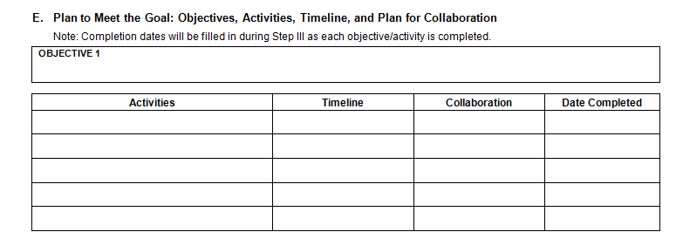
Part E—Meeting the Goal
Objectives:
Specific, observable, and verifiable actions
Completion should result in accomplishing
goal
Three (3) types of objectives
Activities & Timeline:
Lead to the achievement of objectives
Impact professional growth and impact student
learning
Collaboration:
Peers, PDT, and learning communities

Slide 7
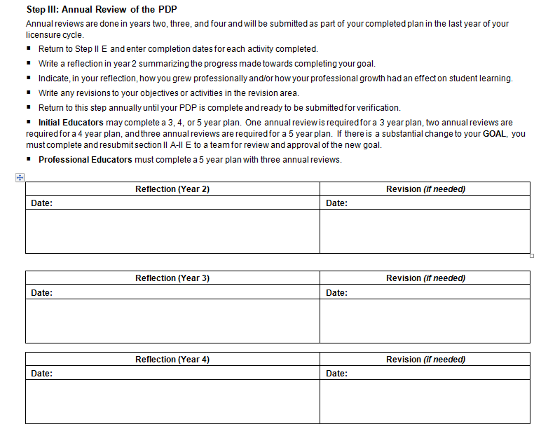
Annual review:
Reflection summary
Revisions to goal (April 1)

Slide 8
The annual review of the plan must include the following:
■ Add completion dates to your objective(s) chart for activities completed during the year.
■ Reflection of how you grew professionally throughout the year, in the standards identified in your plan. (See print in italics below)
■ Reflection of how that growth had an effect on student learning. (See print in bold below)
■ Description of any revisions made in the goal, objectives, or activities. (See underlined print below)
Goal: I will research and implement an early literacy program in my classroom so that students will be immersed in a literacy-rich environment in order to become improved readers in later grades, reflecting higher test scores.
August, 2008--My license expires in 2010 but I began my PDP in 2007, so I am on a 4-year plan for my PDP. I had a very busy, but successful, first year teaching XYZ Grade at XXXXX School.
I am the only XYZ teacher in our school, but an ABC teacher, who is also my mentor, was an excellent resource to me. We made a point to meet at least once a month to touch base on things I needed to be aware of, exchange lesson plan ideas, and just give me an opportunity to ask any questions I had. She and I also attended the annual “Teaching Conference” together in January. We came back with so many wonderful strategies and lessons that I have decided to use in my classroom. Attending a conference made me see an important value in professional development, so next year I would like to attend two other literacy conferences to help me meet my goal. I have added them to objective number 1. A major goal I set out to accomplish this year was to look at different early literacy programs used at schools and begin to use one in my classroom. I still will continue researching other programs by reading books and articles to learn more about early literacy. I did not get a chance to observe reading programs in other classroom, but will definitely try to do so next year. I began some of the parts of the program this year. One of the aspects of my program was to label as many parts of the classroom as I could with their words (table, chair, door, shelf, etc)

Slide 9
I found that the students liked looking for these labels around the classroom and it helped them match words to objects. It was also helpful for them when doing independent writing because they could look at the label to write the word they wanted. Also, seeing the labels on a daily basis got them to remember the words and become familiar with them. Another aspect of my early literacy program was guided reading. In November I introduced guided reading to my students and parents. Each week we would look at a different book in small groups. We would look at the title, pictures, and walk through the book to make predictions and ask questions about the book before reading it. After reading it several times, the students would take the books home on Friday to share with their families. The students and parents loved these books because many of them did not have age-appropriate books at home they could read independently. This directly relates to standard 7, because I am organizing and planning instruction based on my knowledge of the subject matter and the ability of my students. After some reflection, I have decided to take my guided reading program one step further next year and work more on concepts of print before introducing guided reading. I noticed that some students lacked knowledge of parts of a book, the direction of the print, and other skills that made the initial guided reading sessions difficult for them. I also plan to have the parents more involved so they can work with their child on these skills at home. In the spring of this year I began my Masters program to receive my licenses as a reading teacher and a reading specialist. I think that the courses I take for the program with help in developing my early literacy program and help my students become more successful readers in the future. Overall, it was a great year and I am looking forward to making next year even better.

Slide 10
References
Alabama Professional Development Module. (2003). “Implementing
PDP Objectives and Activities.” Retrieved from the World Wide Web on April 12, 2009, at http://web.utk.edu/~mccay/apdm/index.htm
Larson, K. (2008). Celebrating a Change: PI34 Performance-Based
Licensure. CESA 2.
No Other Profession. (1998). Recorded by Garre LaGrone on Thank
A TEACHER [compact disk].
Welcome to the Quote Garden. (2009). Retrieved from the World Wide
Web on April 13, 2009, at http://www.quotegarden.com/teachers.html
When You Wish Upon A Star. (1988). Recorded by Daniel Kobialka on When You Wish Upon A Star [compact disk].
White House Initiative. (2008). Ten Reasons to Become a Teacher.
Retrieved from the World Wide Web on April 5, 2009, at http://www.yesican.gov/publications/tenreasons/

Slide 11
References (continued)
Wisconsin Department of Public Instruction. (2007). PDP Goal Approval Form. Retrieved from the World Wide Web on April 5, 2009, at http://dpi.wi.gov/tepdl/initialed.html/
Wisconsin Department of Public Instruction. (2007). PDP Initial Educator Tool Kit. Retrieved from the World Wide Web on
April 5, 2009, at http://dpi.wi.gov/tepdl/initialed.html/
Wisconsin Department of Public Instruction. (2007). PDP Writing Form. Retrieved from the World Wide Web on April 5, 2009, at http://dpi.wi.gov/tepdl/initialed.html/

Slide 12
I teach…I touch the future.
- Christa McAuliffe

